Slide 1

University of New York Tirana Kristo Cavo Food Delivery Website

Slide 2
About
This website is designed to give the customer the option of food delivery straight to their home.
The user of the website will be able to pick any item from a menu. Once the order is filled out, they are also able to give any specific instructions regarding the order.
The customer needs to be able to: See the entire menu, prices and description. Complete the payment in a convenient way for them. Specify any special requests regarding their order, for whatever reason.
The administrator of the website is able to edit the menu according to what is physically available at the moment.
The administrator needs to be able to: Log in into the website quickly and reliably. Edit the menu based on any specific business reason.

Slide 3
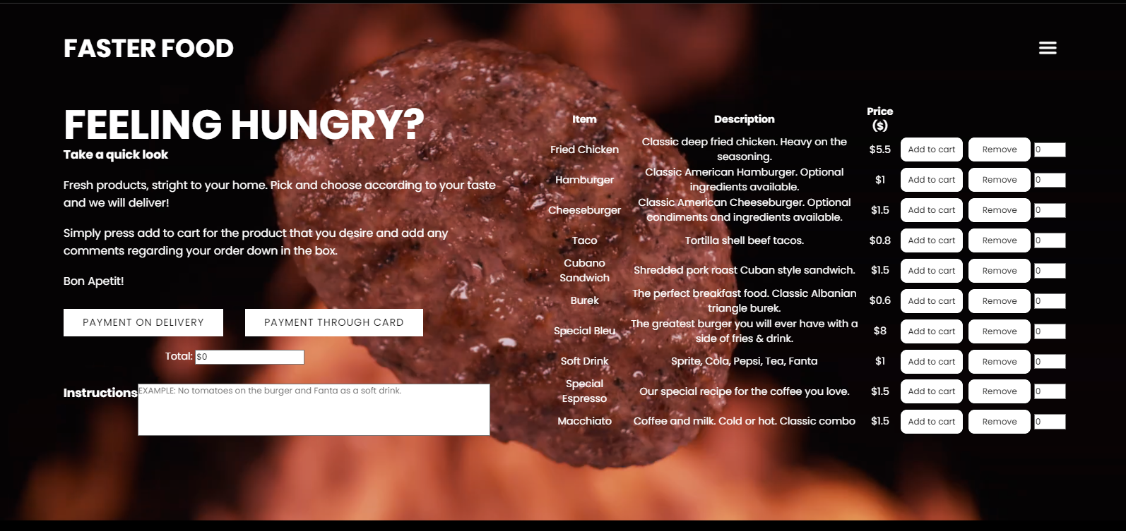
User Interface :
The customer should be able to add items on the menu as they please, and the website will respond accordingly in real time.

Slide 4
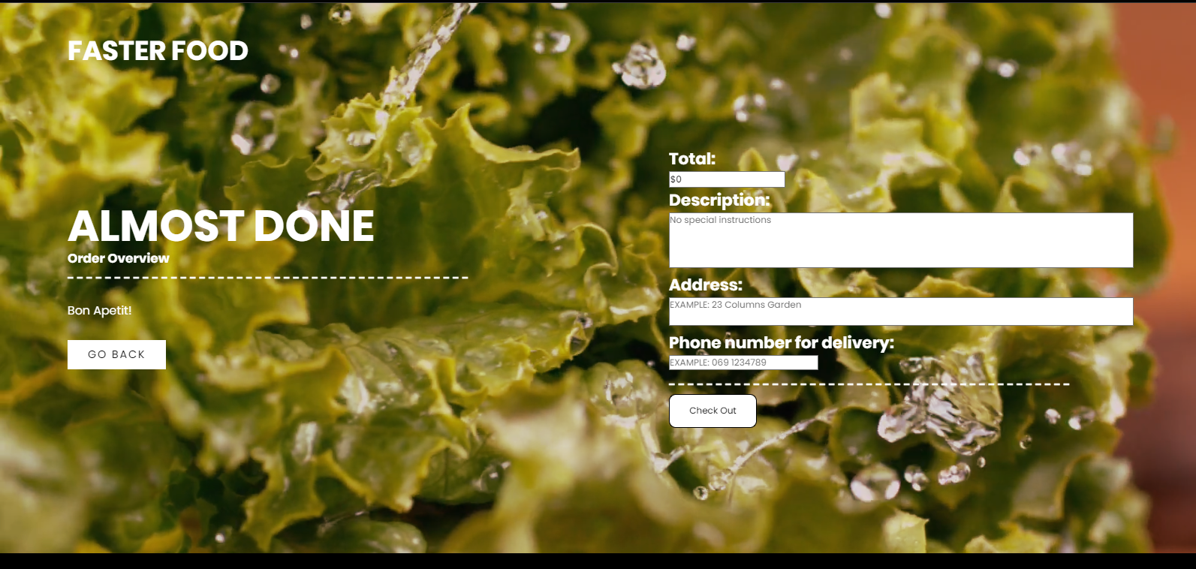
Pay on delivery:
This feature of this web page ; is for clients who want to pay through cash
They can put here their personal information about the orders and also see the total about to be paid

Slide 5
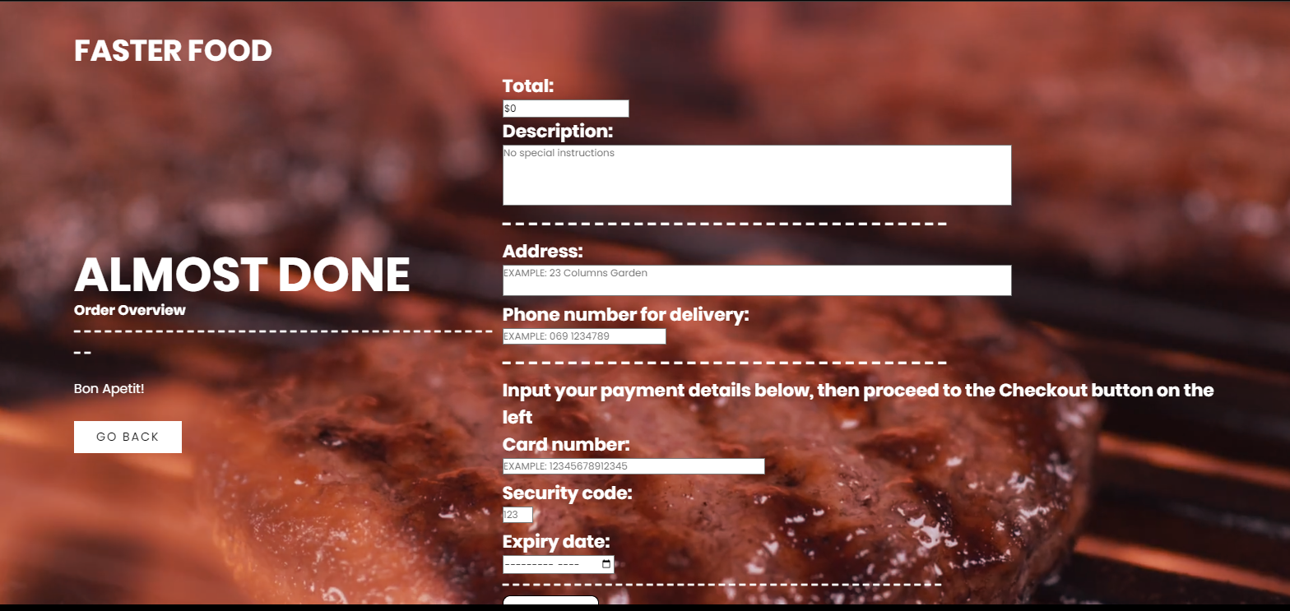
Pay through card
Another feature of the website is payment through card :
This feature is there for convenience purposes.

Slide 6
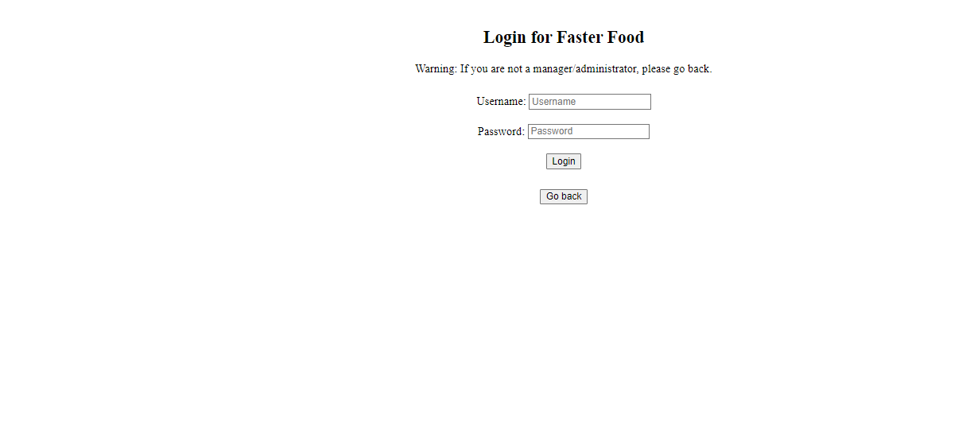
Login interface
Username : admin2
Password : admin2
We thought to make this page as simple as possible

Slide 7
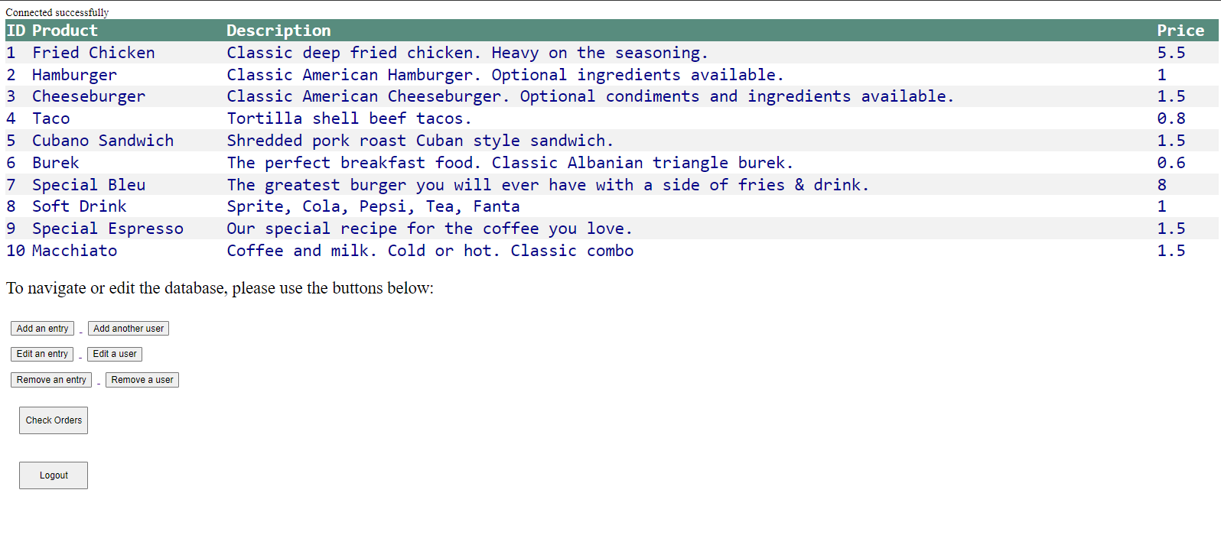
Admin Interface
Admin page: The admin page’s main purpose is to moderate the website and update information based on business requirements. An admin has the ability to add users and menu entries and also remove them accordingly. The admin however, cannot add new orders, he can only remove invalid orders

Slide 8
Features of the project
Usability
This web application is very easy to use, it will be very easy for user to learn and operate the system. Also, the admin interface is built in a way to be easy to use.
Efficiency
The average time it takes to accomplish the user goal (ordering food) it minimalist, so the user can complete its goal without any help, and the number of transactions completed without errors.
Security
Security requirements ensure that the software is protected from unauthorized access to the system and its stored data. It considers different levels of authorization and authentication across different users’ roles.
Target audience
There is no specific target audience for this food delivery website. That being said, design-wise, the website is more catered to the younger generations with a simplistic, clean look.

Slide 9
Conclusion
Overall, we found this to be a very interesting experience when it comes to the design of software. It was a simulation of how a software engineer operates in day-to-day activities and there was a lot of insight to be gained when it comes to project management. We found the model used to be a success, as the time allocated and given each task gave us enough incentive to work at a rapid, yet comfortable rate. The project design turned out to be easy to work with and understandable.
Thank You !

